Slide 1
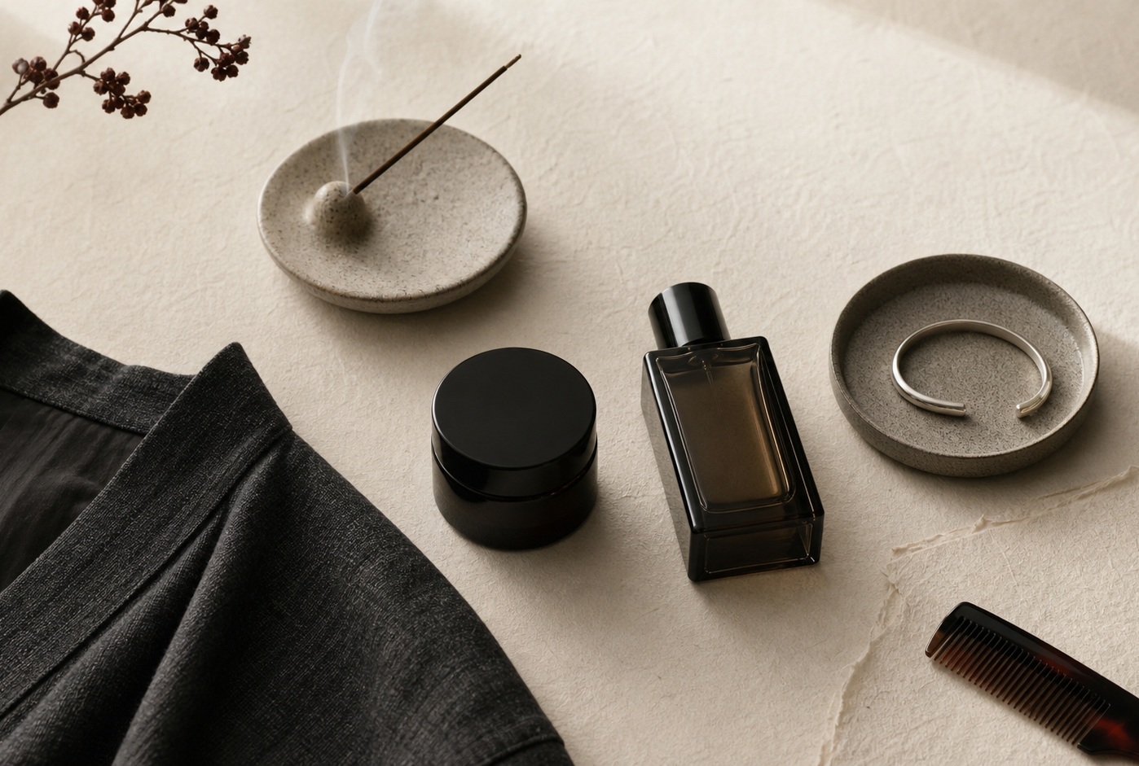
MIDA
Men's lifestyle OS for presence
Japan-led grooming, scent, cool wear, accessories, and ritual packaged into one standard for high-intent men.
$250K
Angel round
Launch MIDA as the Japan standard for men's presence.
2026 launch deck

Slide 2
PRODUCT
Lifestyle first. Grooming is the wedge.
MIDA is a premium men's lifestyle platform: one profile, one presence standard, one purchase path.
Profile
Access
Outfit
Repeat
Face, hair, scent tolerance, style codes, lifestyle contexts, and symbol preference.
Private Japan appointments, partner recommendations, and cultural authority.
Grooming, scent, cool wear, jewelry, ritual objects, and travel-ready kits.
Membership, refills, seasonal style updates, private drops, and concierge care.
The client is not buying products. He is buying certainty about how to show up.
MIDA / Angel round
02

Slide 3

WHY NOW
Men's self-upgrade is fragmented. Japan gives it a standard.
The path is split across grooming, fragrance, clothing, jewelry, creators, boutiques, and travel experiences.
Most men do not want separate beauty, fashion, and wellness rabbit holes. They want context: work, dates, travel, gym, interviews, and social life.
Midashinami gives MIDA the operating principle: clean impression, restraint, etiquette, and care for how you enter a room.
Grooming / Scent / Cool wear / Accessories / Ritual
MIDA / Angel round
03

Slide 4

PRODUCT SYSTEM
One lifestyle profile powers the stack.
KIYOME
Grooming and care anchored in skin, hair, hygiene, and daily polish.
Clean impression
SAHO
Scent, incense, context rules, travel routines, and social readiness.
Lifestyle ritual
SHIRUSHI
Cool wear, starter jewelry, and accessories that read intentional, not loud.
Style signal
Men buy a lifestyle standard, not a random basket.
MIDA / Angel round
04

Slide 5
BUSINESS MODEL
Access creates trust. Kits and membership create repeat purchase.
Private Japan Access
Lifestyle Kits
Membership
$2.5K-$10K curation fee
Skin, scent, style, jewelry, ritual, itinerary, and profile.
Trust builder.
$150-$750 starter + seasonal
Grooming reset, office-safe scent, incense ritual, first silver, cool wear, travel kit.
Margin engine.
$49-$199 / month
Seasonal profile, reorder links, private drops, partner access, and concierge guidance.
Repeat behavior.
$250K funds first proof of premium demand: $140K inventory + partners / $60K founder pay / $50K launch + ops
MIDA / Angel round
05

Slide 6
12-MONTH PLAN
Prove access, conversion, and repeat behavior.
$15.6B
$78.4B
$12.4B
$2.0B
Projected U.S. men's grooming market by 2026
U.S. jewelry market estimate in 2025; men's share expanding
Japan jewelry market estimate in 2025
Japan perfume market estimate in 2025
Q1
Q2
Q3
Q4
Partner access
Pilot tours
Commerce launch
Scale signal
LOIs, itinerary, diagnosis, first content
5-10 paid clients, playbook, kit preorders
Kits, membership, creator/barber channel
Private-label decision, repeat purchase data
Ask: $250K angel round to launch MIDA as the Japan standard for men's presence.
MIDA / Angel round
06

